Slide 1


Live Well. Stay Well.

Slide 2
Goal of todays visit
Please make sure that you complete and return our survey
Help you understand how to identify if you are infected with COVID-19
Understand why this is important to control/limit your exposure and risk
What can we do?
How we will support you at GOH Medical

Slide 3
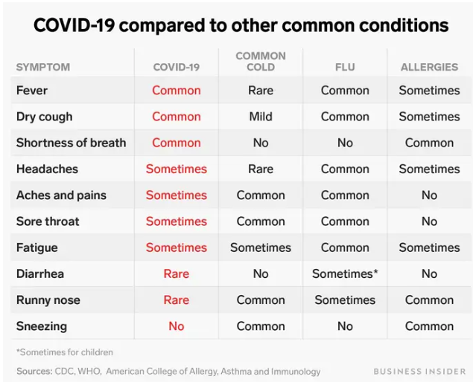
Symptoms and Signs of COVID-19

Slide 4
Current Status North Texas

Slide 5
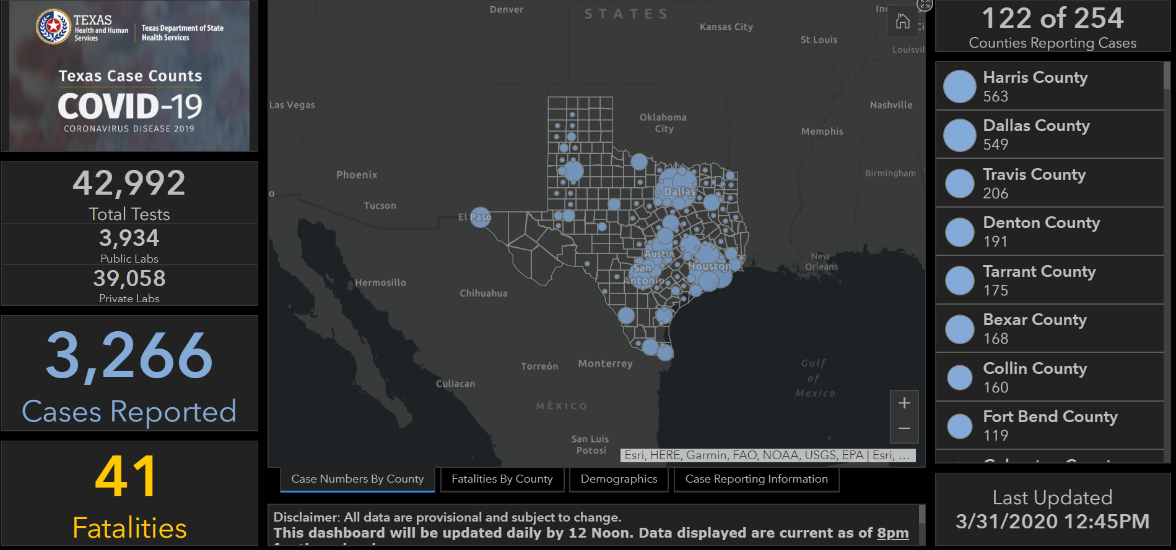
COVID-19 in DFW as of 3/26/20

Slide 6
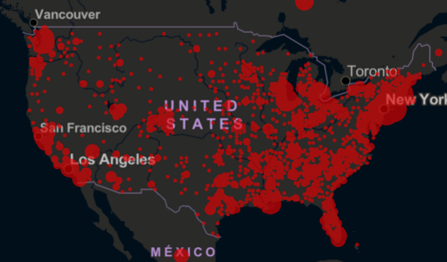
Understanding Spread
FEVER 5.4 Days
Infects Others
Well – 8.4 Days
Day 0
Day 2.2
Day 5.1
Day 11.4
Infected
Incubation Period
First Symptoms
Ill
No Longer Infectious

Slide 7
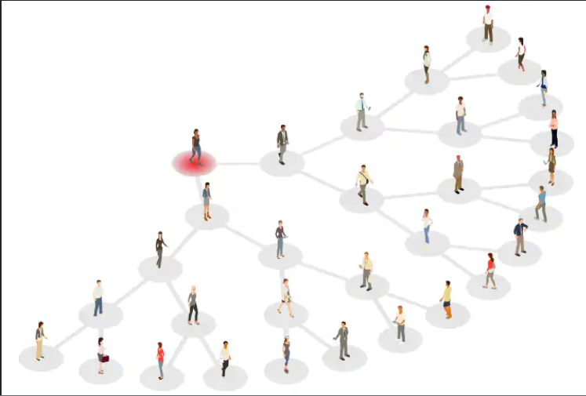
Understanding Spread
Day 11.4

Slide 8
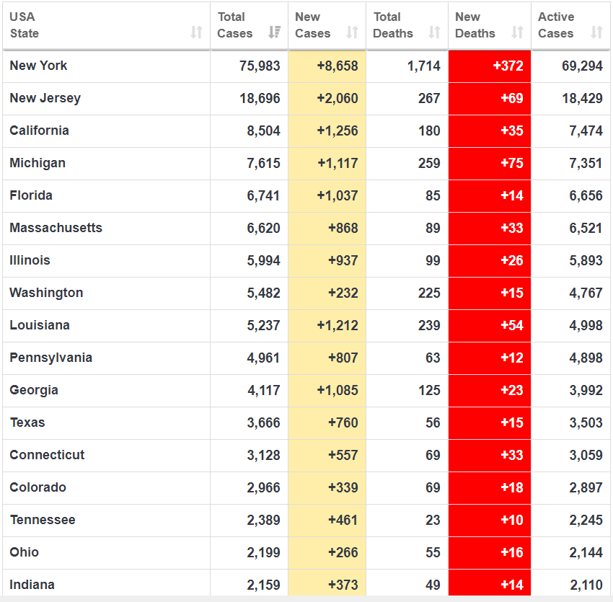
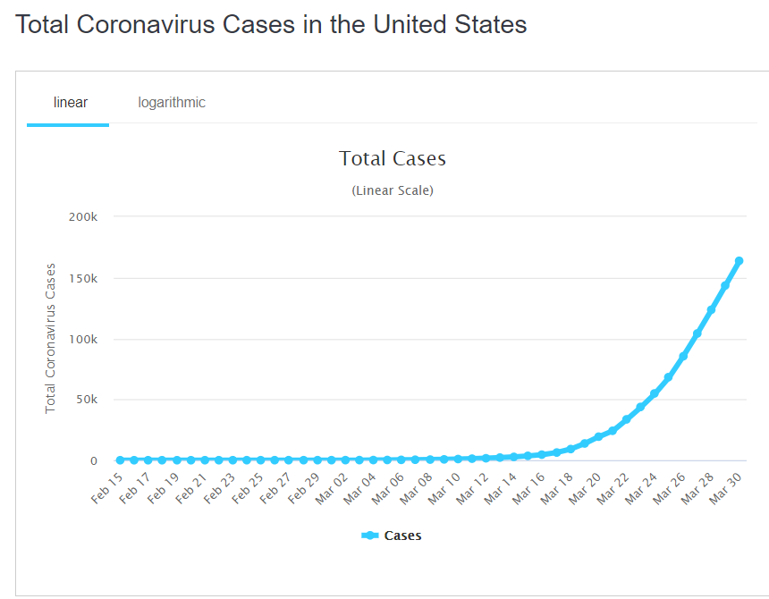

Slide 9
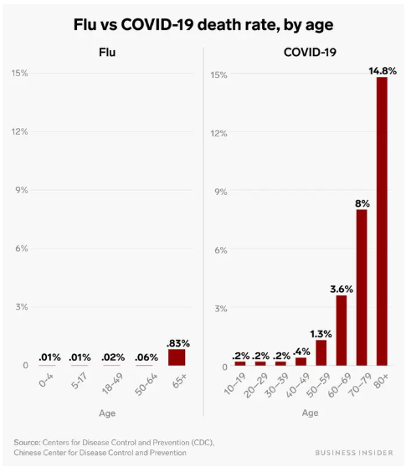
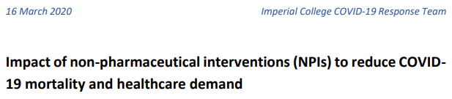
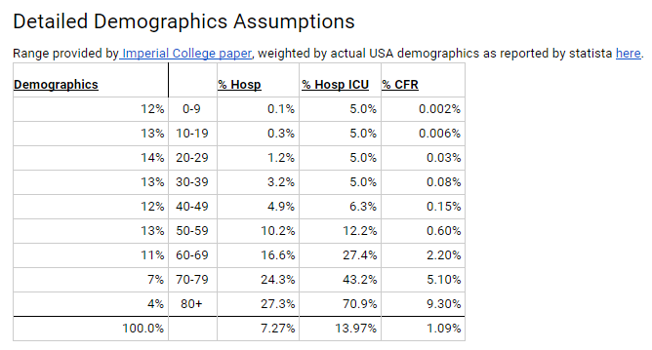

Slide 10
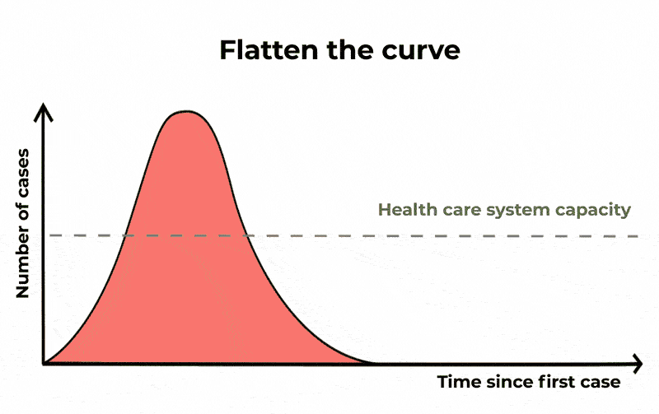

Slide 11
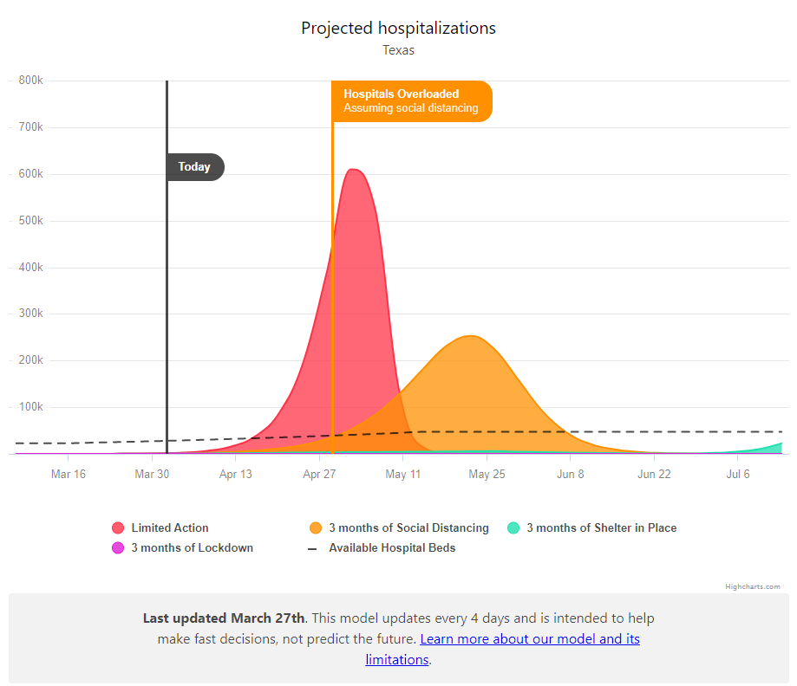
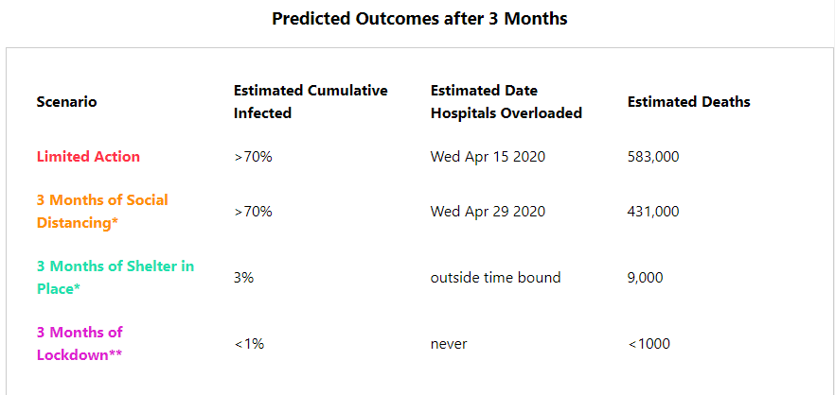

Slide 12
What We Can Do

Slide 13

How to Support Your Immune System: Remember, Let Food Be Your Medicine!
Eat a whole foods, nutrient-dense diet. Our immune system relies on nutrient-dense whole foods to function well. Death from infections in the developing world is often not due to the infection itself but the body’s inability to fight it because of nutrient deficiencies. More than 90% of Americans are deficient in one or more nutrients at the minimum dose to prevent deficiency.
Cut out sugar and refined starches. Studies have shown that refined sugars can suppress your immune system for hours after ingesting.
Ensure adequate protein intake. While most Americans eat adequate amounts of protein, some do not such as the elderly and vegan populations.
Add garlic, onions, ginger, and lots of spices (oregano, turmeric, rosemary) to your meals! Add these to your soups and vegetable dishes, as well as bean dips and sauces. Garlic and onions offer wide spectrum antimicrobial properties.
Eat multiple servings of colorful fruits and vegetables high in vitamins C, A, and phytonutrients that support the immune system. Choose more leafy greens, cruciferous vegetables (broccoli, Brussels sprouts, and cauliflower), peppers, sweet potatoes, and squashes. Aim for 2 servings of fruits and 8 or more servings of vegetables! A serving is half a cup.

Slide 14
How to Support Your Immune System: Remember, Let Food Be Your Medicine!
Eat fermented foods to support your microbiome and immunity. Eat sauerkraut, kimchi, natto, miso, tempeh, unsweetened yogurt, kefir
Alkalize your body. Sugar and processed foods tend to make your body slightly more acidic and more receptive to the COVID-19 virus. Eating whole plant foods and lots of them, 5 to 8 cups a day, is a good way to alkalinize your body. Try making big vegetable and bone broth soups which can help improve your pH.
Drink plenty of fluids, especially warmer fluids. Drink herbal teas like ginger and turmeric tea. Avoid concentrated fruit juices and sweetened beverages, as the sugar content is harmful for the immune system.
Get sufficient sleep! We all know sleep restores and heals the body. Incorporating various relaxation and breathing techniques throughout the day to help with stress and allowing the mind to rest is also very helpful!
Get regular exercise. Mild to moderate exercise (for approximately 30-45 minutes) helps boost the immune system. Avoid overexertion such as training for endurance events when you are feeling run down. If you are able to exercise outside in less populated areas, great. If not find workouts and yoga classes online.
Practice meditation and yoga. The data are clear. Increased levels of stress increase susceptibility to viral infections.
Start a garden. If you live in an area with a lawn or some access to land, grow some of your own food. During WWII, victory gardens produced 40 percent of the food in America.

Slide 15
Identify High Risk Individuals
Who is at higher risk?
Early information out of China, where COVID-19 first started, shows that some people are at higher risk of getting very sick from this illness. This includes:
  Older adults >60
  People who have serious chronic medical conditions like:
    Heart disease
    Diabetes
    Lung disease
  Immunocompromised

Slide 16
Take everyday preventive actions
Clean your hands often
Wash your hands often with soap and water for at least 20 seconds. If soap and water are not available, use a hand sanitizer that contains at least 60% alcohol.
To the extent possible, avoid touching high-touch surfaces in public places – elevator buttons, door handles, handrails, handshaking with people, etc. Use a tissue or your sleeve to cover your hand or finger if you must touch something. Wash your hands after touching surfaces in public places.
Avoid touching your face, nose, eyes, etc.
Clean and disinfect your home to remove germs: practice routine cleaning of frequently touched surfaces (for example: tables, doorknobs, light switches, handles, desks, toilets, faucets, sinks & cell phones)
Avoid crowds, especially in poorly ventilated spaces.

Slide 17
What To Do
Take good care of yourself!
Manage your chronic conditions very well
Let us know if you need refills on any of your medications
Be sure you have over-the-counter medicines and medical supplies (tissues, etc.) to treat fever and other symptoms. Most people will be able to recover from COVID-19 at home. Dayquil/Nyquil/Tylenol
Have enough household items and groceries on hand so that you will be prepared to stay at home for two weeks
If you get ill contact us –
  Appreciate that for mild/moderate symptoms we will manage you at home
  Testing is very restricted in north Texas and only testing for those going into the hospital

Slide 18
Goal of todays visit
Help you understand how to identify if you are infected with COVID-19
Understand why this is important to control/limit your exposure and risk
What can we do?
How we will support you at GOH Medical
  Make sure you are on Spruce
  Be able to log into your Portal
  Get your medications for 90 days
  Contact us with your concerns
  Consider joining the Game of Health Group Visits

Slide 19
Live Well. Stay Well.

