Slide 1


CLINICAL AND COMMUNITY COLLABORATION
ON REDUCING FALLS

Slide 2

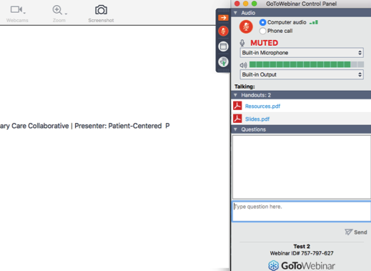




BEFORE WE BEGIN
Click the Handouts pane to download slides and additional resource materials.
Submit your questions anytime by typing in the box. We’ll do Q&A at the end of each session.
Raise you hand (✋) if you’d like to speak, ask questions, or participate in the conversations – You will be unmuted
Adjust the size of the speaker panel and the slide show
3
Speaker Panel
1
4
Slide Show
2

Slide 3


AFTER THE WEBINAR
Please complete the post-webinar survey. Your feedback will be appreciated!
We will send you
the recording and post the slides and additional materials for download at
www.pcpcc.org/webinars

Slide 4

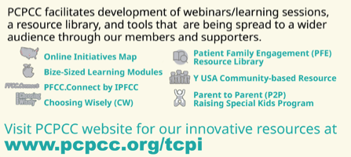

ABOUT PCPCC
Patient Centered Primary Care Collaborative (PCPCC)
Mission:
To promote collaborative approaches to primary care improvement
Patient-Centered Care
Person Family Engagement
Patient Activation
Improved Cost/Quality/Experience Outcomes
PCPCC Support and Alignment Network (PCPCC SAN) is a collaborative approach to improving person and family, clinician, and community strategies for engagement

Slide 5
Objectives
Participants will:
Learn how implementing Choosing Wisely recommendations can help reduce falls in older adults;
Understand the benefits of engaging with a community-based organization to amplify a clinical implementation focused on fall reduction; and
Become familiar with how to team with community-based organizations.

Slide 6


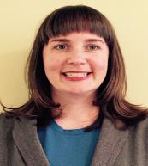
Our Speakers for Today
Lisa Letourneau
MD, MPH, FACP
PCPCC
Marc Rosen, MPH
YMCA OF THE USA
Kelly Rand MA, CPH
ABIM Foundation

Slide 7
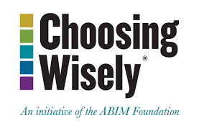

Choosing Wisely is an initiative of the ABIM Foundation to help clinicians and patients engage in conversations about the overuse of tests and procedures and to support physician efforts to help patients make smart, effective choices.
Notes:
Choosing Wisely is about having a conversation about appropriate care. While the tests and treatments named in Choosing Wisely are appropriate in some situations, CW focuses on those patients and situations where the named test or treatments harms outweigh the benefits. Within this context we include financial harm to the patient as a factor for consideration.
While Choosing Wisely is about utilizing the most appropriate tests and treatments to avoid harm and keep patients safe, a byproduct of this effort is fewer patients receiving unneeded care and will result in fewer dollars spent on health care.

Slide 8

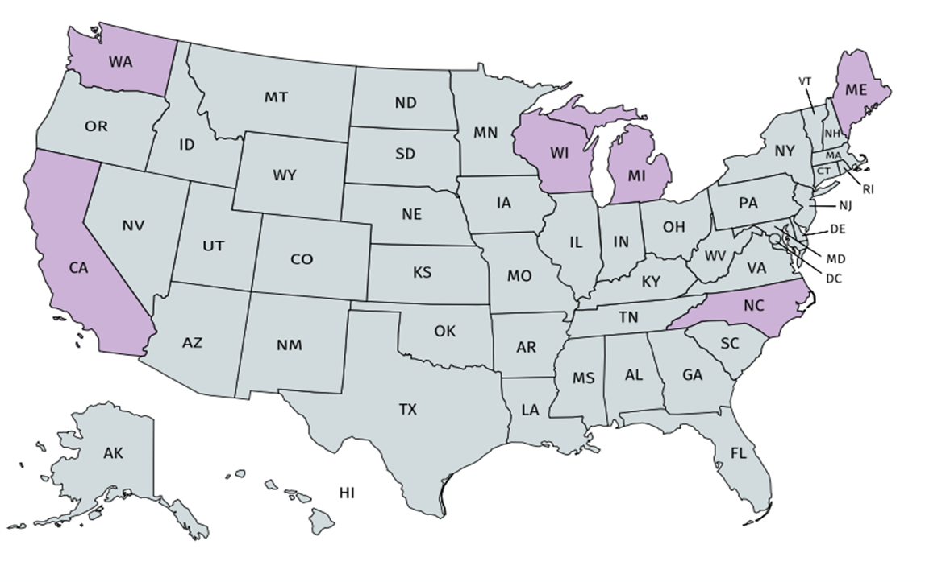
Stimulating Innovation and Implementation
The Robert Wood Johnson Foundation provided two rounds of funding to advance Choosing Wisely, including a grant of $4.2 million to support seven initiatives focused on reducing utilization of unnecessary tests to support multi-stakeholder community efforts.
Grantee Organizations
Greater Detroit Area Health Council
Integrated Healthcare Association (CA)
Maine Quality Counts
North Carolina Healthcare Quality
Alliance
University of California, Los Angeles
Washington Health Alliance
Wisconsin Collaborative for Healthcare Quality
Notes:
The campaign began as a communications effort to share recommendations for things to question or reduce. The second phase of our work was investing in conversation tools and helping communities and health systems begin to have these conversations For the last four years we have begun to focus on stimulating implementation of these concepts and the campaign. We teamed with the Robert Wood Johnson Foundation to offer a little over $4 million to support community implementation. The communities were made up of at least two major health systems, a multistakholder organization and a clinician education organization working together to reduce three areas of overuse.

Slide 9
Multi-component Intervention
Identify targeted clinicians
Identify metric to be used – should be tested – and best if 40% or more
Set rewards, both non-financial and financial
Education on recommendations and clinical pathways
Clinician benchmarking/feedback
Clinical decision support
Prepare the patients
Sustain the gains

Slide 10
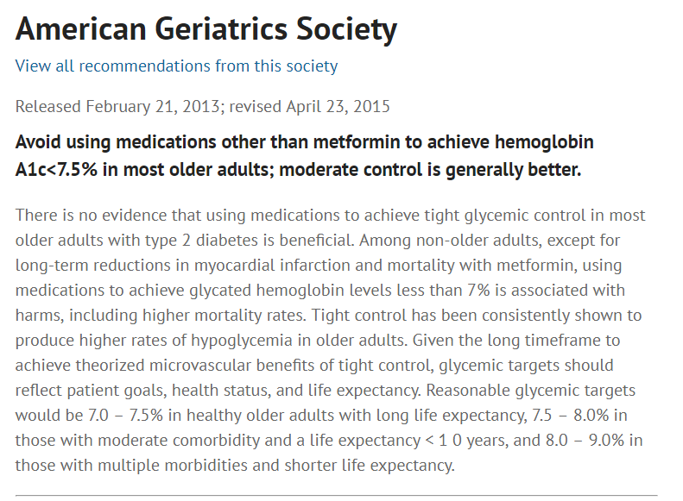


Slide 11
VA Choosing Wisely Task Force
Hypoglycemic Safety Initiative (HSI)
  Nearly three in 10 veterans over 65 have diabetes
  Recommendations:
  Review patients at greatest risk for hypoglycemia
  Identify an individualized A1C goal based on patient preferences, complications, and co-morbidities
  Reduce or eliminate unwarranted medications, focusing on insulins or sulfonylureas first as they pose the greatest risk for hypoglycemia
  In general, the goal is to relax the A1C target when appropriate based on evidence and safety. Preference is to evaluate A1C target before considering adding alternative agents.

Slide 12
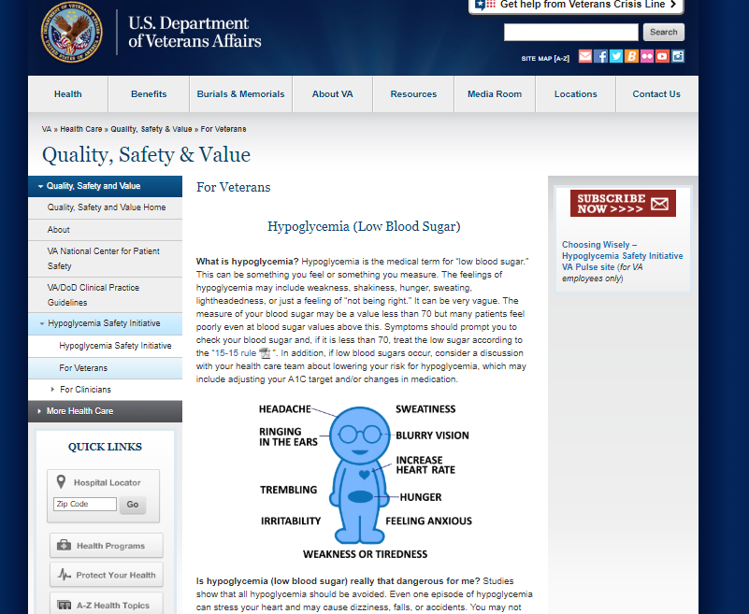
Intervention plan
All members of the care team encouraged to take responsibility for identifying high-risk patients
Created a simple template in EHR that reminds clinician the patient is in the high-risk group and prompts discuss ion of individualized glucose control targets
Created Online toolkit for both patients and clinicians

Slide 13
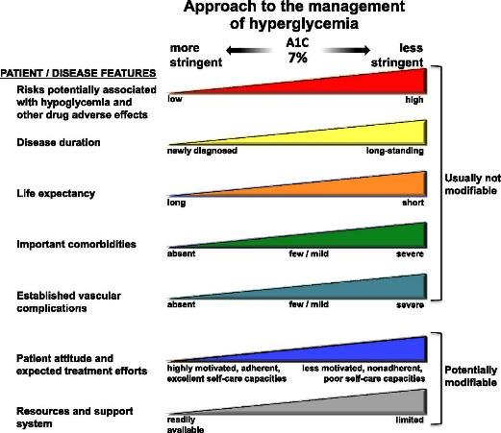
As a Balancing Measure

Slide 14
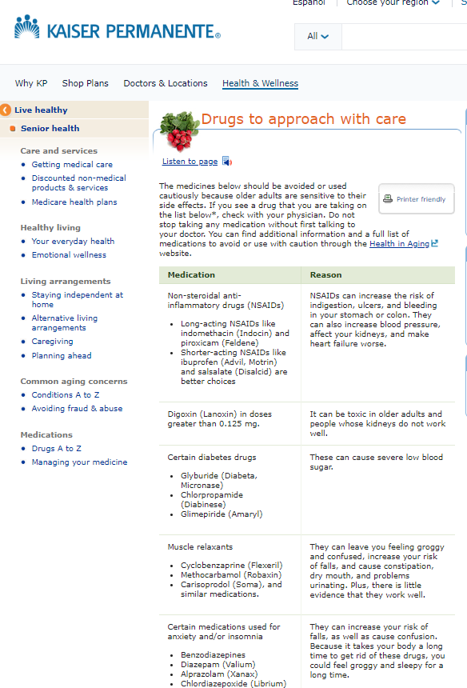
Southern California
High Risk Drugs in the Elderly Committee
Clinician education
Patient awareness
Physician champion

Slide 15
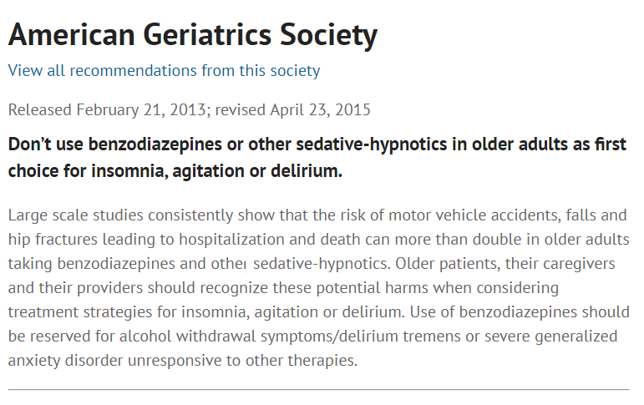


Slide 16
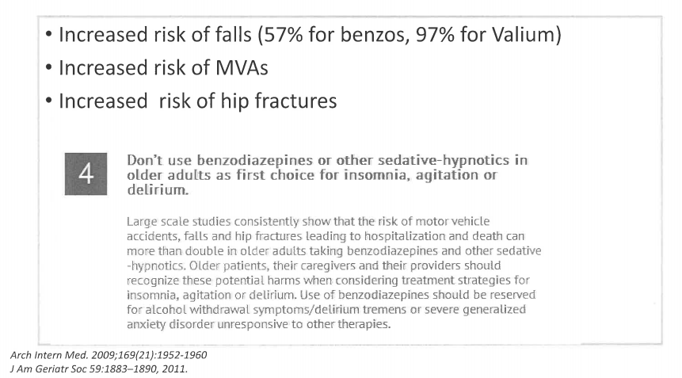
Cedars Sinai

Slide 17
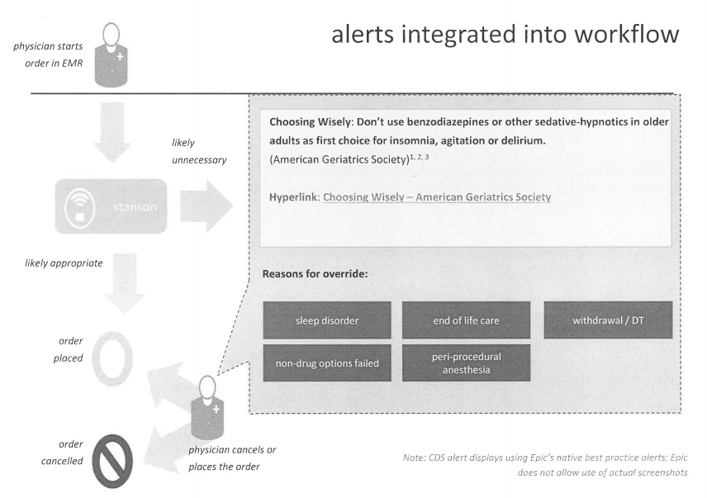

Slide 18
Maine Quality Counts:
Spreading Choosing Wisely in Two Communities
3-year effort focused on spreading Choosing Wisely messaging in 2 geographic communities
Partnered with health care provider groups & community organizations
Focused on 3 specific areas:
  Decrease antibiotics for URI
  Decrease imaging for low back pain
  Decrease use of benzodiazepines in older adults

Slide 19
Maine Quality Counts – Community Partnerships
Partnered with health care marketing staff to push messaging into communities:
  Existing community educational events
  Social media marketing
  Offered attractive alternatives (e.g. URI “Care Packs”)
Partnered with community agencies to link with community partners, spread messaging using community organizing strategies

Slide 20
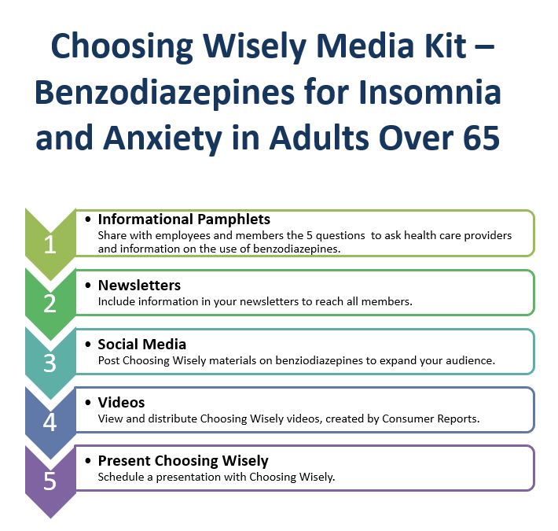
Maine Quality Counts Community Efforts

Slide 21
Maine Clinical Reduction Efforts
MidCoast Med Grp
• Clinician education
• Clinical champions
• POC decision support
• Performance feedback
• Workflow changes
Penobscot Comm Hlth Care
• Clinician education
• Clinical champions
• POC decision support
• Performance feedback
• Workflow change
• Patient education
~20% reduction
~40% reduction

Slide 23

Our commitment to healthy living
Clinical and community collaborations on reducing falls
August 15, 2019
© 2019 YMCA of the USA

Slide 24


Our Cause
Strengthening Communities
Notes:
We believe the Y should be a part of addressing this problem because our cause is to strengthen communities. We do this through our three areas of focus: youth development, healthy living, and social responsibility. You may know us more for our work in aquatics, camp, or being a fitness facility, but we’ve been on a journey to be strengthen our public health capacities over the past several years.

Slide 25
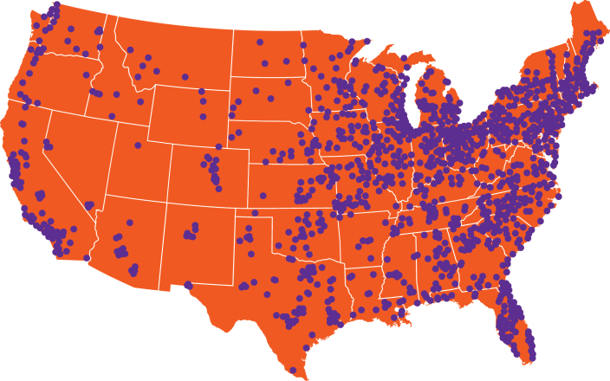
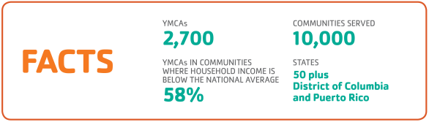
OUR REACH
Notes:
Building a foundation at the Y must take into account the volume and spread of our organization. We are a federated non-profit organization that includes approximately 800 Y Associations with 2,700 branches across 10,000 communities.

Slide 26


FRAMEWORK FOR HEALTHY LIVING
Impacting
INDIVIDUALS
Impacting
FAMILIES
Impacting
ORGANIZATIONS
Impacting COMMUNITIES
Impacting
SOCIETY
Personal Training
Employee Wellness Benefits
Built Environment
Economic Incentives and Disincentives (taxation or subsidies)
To
PROMOTE WELLNESS
(Primary)
Wellness Centers
Group Exercise
Family Camp
Policies Promoting Healthy Eating
Policies Promoting Physical Activity
Access to Fresh Fruits & Veggies
Youth Sports
Adventure Guides
Swim Lessons
P.E. in Schools
Safe places for active play
Tobacco-free
Environments
To
REDUCE
RISK
(Secondary)
Diabetes Prevention
Childhood Obesity
Falls Prevention
Smoking Cessation
Medicare Coverage of Diabetes Prevention
To
RECLAIM
HEALTH
(Tertiary)
Cardiac Rehab
Diabetes
Control
Arthritis
Treatment
Cancer Survivorship
MEMBERSHIP
Notes:
Where Ys started by addressing SDOH in collaboration with other coalition stakeholders through a collective impact model focusing on PSE. This led Ys to move down and across the framework to develop organizational competencies in delivering evidence-based interventions at various levels of the socioecologic model and down the health impact pyramid to align risk with a corresponding intervention.

Slide 27
Clinical practice guidelines for fall prevention

Slide 28
Stopping elderly accidents, deaths, and injuries: interventions to address fall risk
Created by the CDC Injury Center
Three Core Elements:
    Screen Patients for fall risk
    Assess modifiable risk factors
    Intervene to reduce risk by using effective clinical and community strategies
Website: https://www.cdc.gov/steadi/about.html
Notes:
The CDC’s STEADI initiative offers a coordinated approach to implementing the American and British Geriatrics Societies’ clinical practice guideline for fall prevention. STEADI consists of three core elements: Screen, Assess, and Intervene to reduce fall risk.

Slide 29
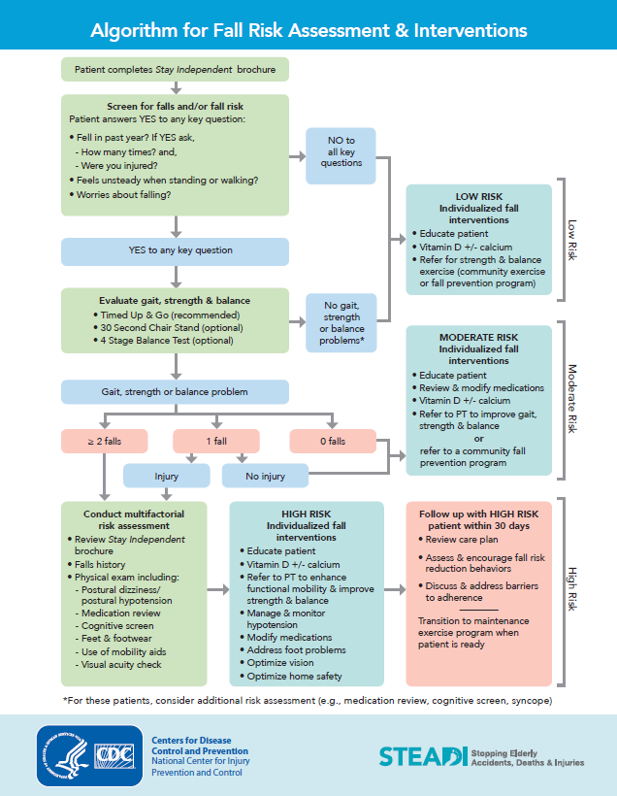
Algorithm for fall risk assessment and interventions

Slide 30
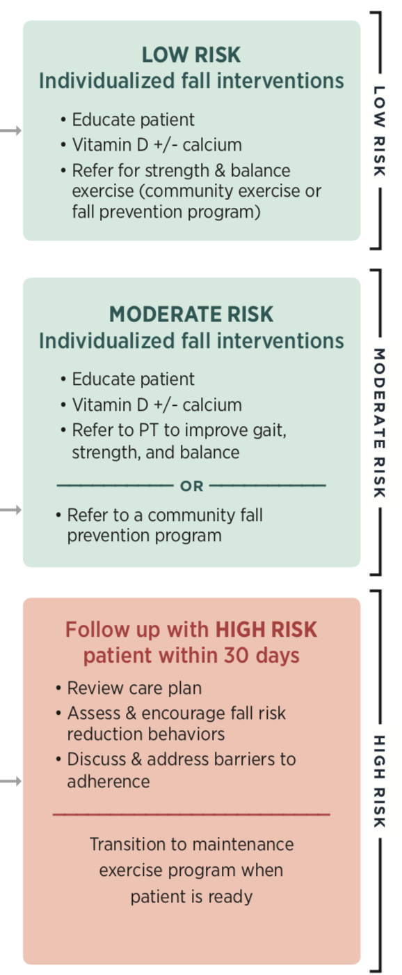
Risk appropriate interventions

Slide 31
Health care efforts to address falls

Slide 32
Value-based payment and falls
Quality Payment Program
HEDIS
Notes:
As the leading cause of both fatal and nonfatal injuries for older adults, falls are one of the most common and significant health issues facing people aged 65 years or older (Schneider, Shubert and Harmon 2010). Moreover, the rate of falls increases with age (Dykes et al. 2010).
Older adults are five times more likely to be hospitalized for fall-related injuries than any other cause-related injury. It is estimated that one in every three adults over 65 will fall each year (Centers for Disease Control and Prevention 2015).
In those over age 80, the rate of falls increases to fifty percent (Doherty et al. 2009).
Falls are also associated with substantial cost and resource use, approaching $30,000 per fall hospitalization (Woolcott et al. 2011).
Identifying at-risk patients is the most important part of management, as applying preventive measures in this vulnerable population can have a profound effect on public health (al-Aama 2011).
Family physicians have a pivotal role in screening older patients for risk of falls, and applying preventive strategies for patients at risk (al-Aama 2011).

Slide 33
Quality payment program fall risk measure
CARE- 2: Falls: Screening for Future Fall Risk
Percentage of patients 65 years of age and older who were screened for future fall risk at least once during the measurement period.
    Numerator: Patients who were screened for future fall risk at least once within the measurement period
    Denominator: Patients aged 65 years and older with an eligible visit during the measurement period
Notes:
Definitions
Screening for Future Fall Risk: Assessment of whether an individual has experienced a fall or problems with gait or balance. A specific screening tool is not required for this measure, however potential screening tools include the Morse Fall Scale and the timed Get-Up-And-Go test.
Fall: A sudden, unintentional change in position causing an individual to land at a lower level, on an object, the floor, or the ground, other than as a consequence of sudden onset of paralysis, epileptic seizure, or overwhelming external force

Slide 34
Hedis measures
Discussing Fall Risk: Medicare beneficiaries 65 and older with balance or walking problems or a fall in the past 12 months, who were seen by a practitioner in the past 12 months and who report discussing falls or problems with balance or walking with the practitioner.
Managing Fall Risk: Medicare beneficiaries 65 and older who had a fall or had problems with balance or walking in the past 12 months, who were seen by a practitioner in the past 12 months and who report receiving fall risk intervention from the practitioner.
Notes:
Performance in reaching the cut point for that specific measure. Number goes to quality rating. Cut point for that measure equates to the range that equates to each scoring section for 1-5.

Slide 35
YMCA fall prevention programming

Slide 36
The Y’s Portfolio of evidence-based (RCT Proven) programs
DISCOVERY
DEVELOPMENT
DISSEMINATION
Efficacy
Validation
Translation
Scaling
Dissemination
YMCA’s Diabetes Prevention Program
Enhance Fitness (Arthritis Self-Management)
LIVESTRONG at the YMCA (Cancer Survivorship)
Moving For Better Balance (Falls Prevention)
Blood Pressure Self-Monitoring
Childhood Obesity Intervention
Brain Health
Building the pool of the 21st century
Parkinson’s
Tobacco Cessation
Notes:
The national office developed a process for vetting, adopting, and scaling randomized controlled trial interventions in the Y system. We have nationally supported interventions at various stages of scale, in addition to the interventions taking place locally at Ys that aren’t nationally supported but still evidence-informed or evidence-based. This can include addressing conditions like diabetes management, chronic pain management, depression, and social isolation.
Other HHS evidence-based fall prevention programs:
A Matter of Balance
Enhance®Fitness
The Otago Exercise Program
Tai Chi: Moving for Better Balance
Stepping On

Slide 37

Enhance®Fitness
THE PROGRAM IS:
For older adults at all fitness levels and is especially beneficial for older adults living with arthritis
Land-based group exercise program for older adults
Delivered in 16-week intervals: 48 sessions per cycle
Open to all community members; YMCA membership is not required
Nationally recognized by the Centers for Disease Control and Prevention, US Department of Health and Human Services, Administration for Community Living, and the National Council on Aging
Involves fitness checks, data collection, and data entry
Notes:
Class length and frequency
1 hour, 3 times per week
Ongoing sessions
Class size
25 participants (recommended max.)
15+, use an assistant
Purpose: To help instructors manage a large group:
Assist instructor with room setup--chairs, weights, etc.
Assist instructor in taking attendance and recording results of fitness checks
Assist participants in putting on their weights--the more frail the participants, the more necessary this is.
Help with relationship building and retention
Demonstrate a seated variation of an exercise while the instructor demonstrates the standing variation (or the reverse)
Adjustable soft ankle and wrist cuff weights
Chairs with arms recommended for Level 1 (seated) classes
Sturdy, straight-backed, armless chairs for Level 2 (standing) classes
Fitness check equipment (stop watch, measuring tape, 5- and 8-pound hand weights, cone)
Information about ordering weights can be found in the EnhanceFitness Implementation Guide on Exchange.

Slide 38
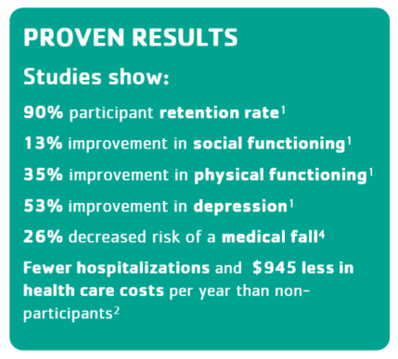
Enhance®Fitness - by the numbers
PROGRAM REACH
Number of Y associations offering the program | 226
Number of states delivering the program | 45
Number of EnhanceFitness sites 86% Y Sites; 14% non-Y sites | 461
Number of participants served | 30,745
References:
1.Wallace JI, Buchner DM, Grothaus L, Leveille S, Tyll L, LaCroix AZ, Wagner EH. (1998). Implementation and effectiveness of a community-based health promotion program for older adults. Journal of Gerontology 53A (4): M301-M306.
2.The Centers for Medicare and Medicaid Services. (2013).Report to Congress: The Centers for Medicare and Medicaid Services’ evaluation of community-based wellness and prevention programs under section 4202 (b) of the Affordable Care Act. Washington: Government Printing Office.
3.Senior Services. (2013). What is EnhanceFitness?. Retrieved from http://www.projectenhance.org/EnhanceFitness.aspx and Y-USA evaluation findings.
4.Greenwood-Hickman MA, Rosenberg DE, Phelan EA, Fitzpatrick AL. Participation in Older Adult Physical Activity Programs and Risk for Falls Requiring Medical Care, Washington State, 2005-2011. Prev Chronic Dis 2015;12:140574
Notes:
A majority of participants improved their lower body strength as measured by the chair stand test, Jan 2013-Sep 2017 (74% improved or maintained at average or above)
A majority of participants improved their upper body strength as measured by the arm curl test, Jan 2013- Sep 2017 (74% improved or maintained at average or above)
About half of participants improved their agility/dynamic balance as measured by the up and go test, Jan 2013-Sep 2017 (54% improved or maintained at average or above)
References:
1. Wallace JI, Buchner DM, Grothaus L, Leveille S, Tyll L, LaCroix AZ, Wagner EH. (1998). Implementation and effectiveness of a community-based health promotion program for older adults. Journal of Gerontology 53A (4): M301-M306.
2. The Centers for Medicare and Medicaid Services. (2013). Report to Congress: The Centers for Medicare and Medicaid Services’ evaluation of community-based wellness and prevention programs under section 4202 (b) of the Affordable Care Act. Washington: Government Printing Office.
3. Senior Services. (2013). What is EnhanceFitness?. Retrieved from http://www.projectenhance.org/EnhanceFitness.aspx and Y-USA evaluation findings.
4. Greenwood-Hickman MA, Rosenberg DE, Phelan EA, Fitzpatrick AL. Participation in Older Adult Physical Activity Programs and Risk for Falls Requiring Medical Care, Washington State, 2005-2011. Prev Chronic Dis 2015;12:140574

Slide 39
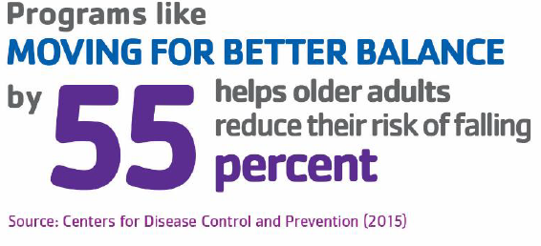
Moving for better balance
The program is:
For individuals 65 years or older, physically mobile, with impaired stability and/or mobility and individuals 45 years or older with a condition that may impact stability and/or mobility
Small group program based on 8 forms of Tai-Chic based movements, modified specifically for falls prevention
Delivered in 12-week intervals: 24 sessions per cycle
Involves fitness checks, data collection, and data entry
Notes:
Moving for Better Balance is a 12-week evidence-based, instructor-led group program designed to improve strength, mobility, flexibility, and balance for enhanced overall physical health and better functioning in daily activities. Participation in the program may also result in better mental health, reduced stress, improved memory and cognition, and increased self-esteem. The program, based on the principles of Tai Chi, teaches eight movements modified especially for falls prevention. Participants meet twice per week in a safe and comfortable learning environment; each session is led by a qualified instructor. Participants are also encouraged to complete 2+ hours of at-home practice each week. The program is targeted toward individuals 65 years or older who are physically mobile with impaired stability and/or mobility, or individuals 45 years or older with a condition that may impact stability and/or mobility.
Program Goal Participants in Moving for Better Balance are working to achieve at least 50 hours of practice in tai-chi based movements, through class instruction and at-home practice.
Essential Program Components and Activities The program teaches eight Tai Chi-based movements modified especially for falls prevention over the course of 12 weeks. Participants meet twice per week in a safe and comfortable learning environment and conduct 2+ hours of at-home practice each week. Each session is led by a qualified instructor
Reasoning Behind the Program Design and Elements Moving for Better Balance was developed by Fuzhong Li, PhD at the Oregon Research Institute with funding from the Centers for Disease Control and Prevention. According to the CDC, each year more than 1.5 million Americans will have a stroke or heart attack, which may result in impaired balance and mobility. Research has shown that Tai Chi-based programs like Moving for Better Balance may aid rehabilitation for those age 45 or older with heart disease.1 Research has also shown that participants in Tai Chi classes had fewer falls, fewer fall injuries, and their risk of falling was decreased by 55 percent.2
Recommended Class Size A class size of 10 to 12 participants is best. With a larger room and an experienced instructor (three plus years of teaching), a class size of 12 to 15 students may also be appropriate.
Health Outcomes and Evidence Supporting Health Outcomes Moving for Better Balance has been shown to: • Improve balance and stability • Increase muscle strength • Improve flexibility • Increase mobility • Improve memory and cognition • Improve self-confidence • Reduce stress • Improve mental and emotional well-being • Prevent falls
Program Savings A cost-benefit analysis of return on investment (ROI) for falls prevention programs showed that the Tai chi: Moving For Better Balance program had a net benefit per participants of $529.86 and an ROI of 509%. 3
References 1. Taylor-Piliae, R. E., et al. (2012). Tai Chi as an adjunct physical activity for adults aged 45 years and older enrolled in phase III cardiac rehabilitation. European Journal of Cardiovascular Nursing, 11(1), 34-43. 2. Stevens JA. Compendium of Effective Fall Interventions: What Works for Community-Dwelling Older Adults. Atlanta, GA: Centers for Disease Control and Prevention, National Center for Injury Prevention (2010). 3. Carande-Kulis, V., et al., A cost–benefit analysis of three older adult fall prevention interventions, Journal of Safety Research (2015), http://dx.doi.org/10.1016/j.jsr.2014.12.007.

Slide 40
Clinical integration examples
Y
Next Gen ACO Participant
Pre-and-post joint replacement falls prevention program
Y
Shared Space Health Care Partner (PCP, PT)
Falls prevention program under direct supervision
Y
Primary Care Practice
Falls Prevention
Notes:
Health reform efforts are slowly shifting the financial incentives from fee-for-service to health outcomes
Success in a value-based payment contract requires a progressive population health strategy
Addressing non-clinical care is increasingly important
Successful population health strategies integrate health systems, providers, and community-based health promotion programs to address the breadth of health issues facing a population
Clinical Pathways connect high-risk patients to appropriate interventions that promote sustained lifestyle change
CBOs become the preferred provider of an evidence-based primary, secondary, and/or tertiary intervention for a defined patient population
CBO evidence-based programs increases a partner’s capacity to provide preventive health strategies that improve clinical outcomes and reduce overall healthcare expenditures.

Slide 41
Where to start?

Slide 42
New, Effective partnerships with cbos
DEVELOP FORMAL REFERRAL PATHWAY
IMPLEMENT A SUSTAINABILITY PLAN
Articulate and formalize:
Shared goals & objectives
Roles
Sustainability plan
CBO BECOMES PREFERRED PROVIDER
ONGOING PARTNERSHIP EVALUATION
Impact
Understanding each partner’s value statement
Aligned efforts
Shared accountability for success
Notes:
And today this is what we’re learning are important characteristics for effective partnership development between CBOs like the Y and health plans and/or provider organizations. When collaborations are approached in this manner, we believe they can transform from transactional ones that involved an initial proposal, exchange of funds, and a final report to one that leverages the collective competencies, resources, and reach of the respective organizations.
DEVELOP FORMAL REFERRAL PATHWAY: CBO receives direct referrals for evidence-based, preventive health strategie
CBO BECOMES PREFERRED PROVIDER: CBO demonstrates improvement of clinical outcomes (and reduction in overall healthcare expenditures)
DEVELOP A SUSTAINABILITY PLAN: CBO demonstrates value-add to health care stakeholder and receives fair market reimbursement for evidence-based service/program
ONGOING PARTNERSHIP EVALUATION: Bi-directional information and outcome sharing drives refinement of referral pathway and reimbursement model

Slide 43
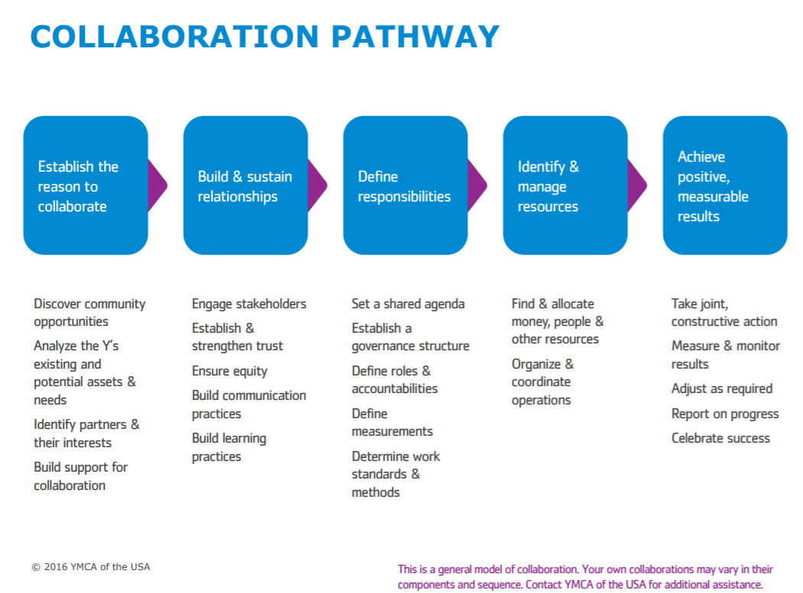

Slide 44
Marc Rosen, MPH
Director, Healthcare Integration and Translation
Marc.rosen@ymca.net

Slide 45

THANK YOU!
Merilyn Francis, Project Director
Merilyn Francis, BSN, MPP: Project Director
+1 202 417 3911
+1 202 417 3911
mfrancis@pcpcc.org
mfrancis@pcpcc.org
Visit our website at: www.pcpcc.org

